Slide 1
Baby Sleep App
Team 4

Slide 2
Table of Contents
Overview
Client
Features
Technology

Slide 3
Overview
Cross-platform mobile app for parents of 0-6 year olds to:
Track events related to their baby’s sleep
Communicate with their sleep coach
Follow their sleep plan
Web-based interface for sleep coaches to:
manage their clients profiles
view baby information
add new sleep plans to their client’s babies

Slide 4


Client
Sergio’s sister, Camila
Certified Pediatric Sleep Consultant
Has coached over 300 families
Is currently using 3 apps to achieve the desired functionality
Notes:
() => {}

Slide 5
Critical Features
Tracking Sleeping, Napping, Eating, Medicine - Mobile
Client/Coach Chat - Mobile & Web
Reach goal to send voice memos and images
Administration - Web
Owner controls Coach accounts, Coaches control Client accounts
Baby Profiles - Mobile & Web
DOB, Weight, Gender, Name, Metrics

Slide 6
Extra Features (Reach Goals)
Sleep Data Analytics View
Coach Notes on Baby Profiles
Sleep Log
Ability for Clients to View/Download PDFs of Sleep Plans
Ability for Coaches to Upload Sleep Plans PDFs
Ability to Switch the App’s Language

Slide 7
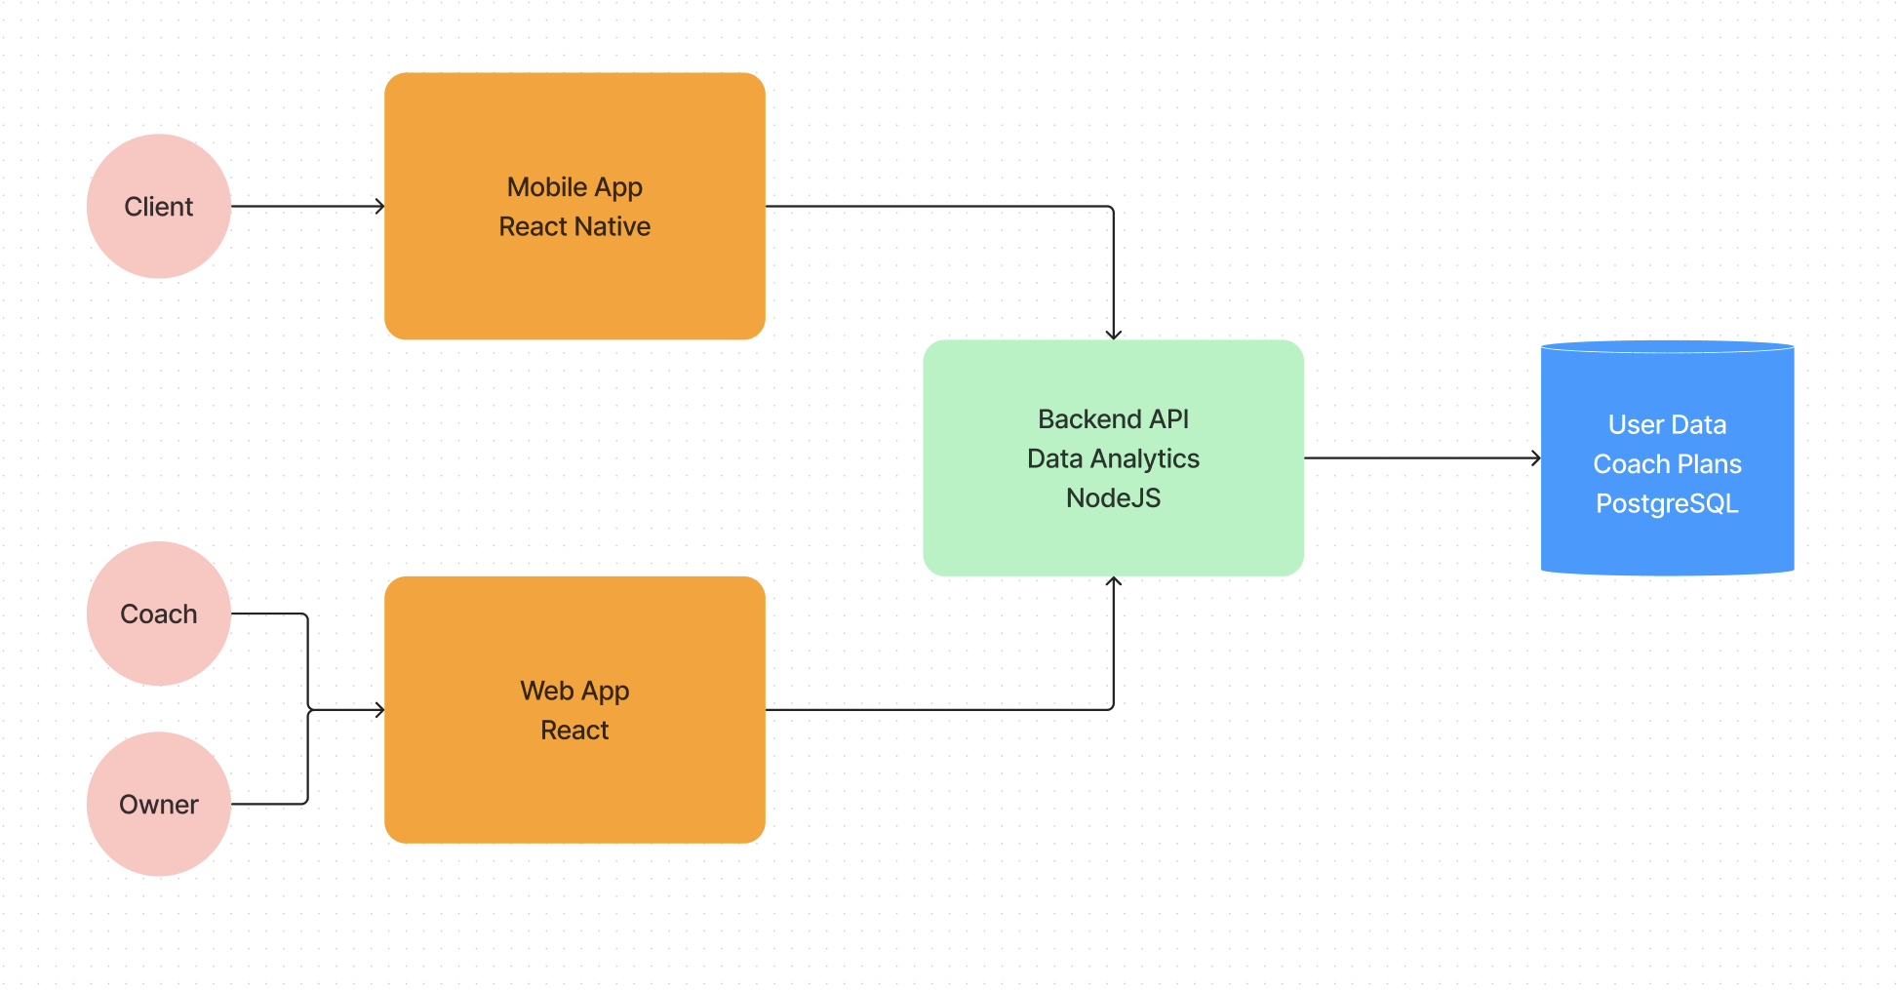
Technology
Web: React, Node.js
Candidates: Flutter, React Native
Mobile: React Native, Node.js
Candidates: Flutter, Capacitor
Database: PostgreSQL
Candidates: Firebase, InfluxDB, MySQL
Project Management: Zenhub
Candidates: Jira
Wiki: Notion
Candidates: Github Wiki

Slide 8
Web View App vs Mobile App
 | Web View | Mobile
Development | Easier to develop | More time consuming
Maintenance | Easier maintenance | More difficult maintenance
Distribution | Easier distribution | More difficult distribution
UI/UX | Worse UI/UX | Better UI/UX
Responsiveness | Less responsive | More responsive
Offline Support | No | Yes

Slide 9
Questions? Feedback?

